Slide 1
Supporting Participation for All Children: Essential Features of High Quality Inclusion
Series on High Quality Inclusion
Webinar #2
Notes:
Welcome everyone to the second in a series of three webinars focused on questions that frequently arise when local early childhood programs collaborate to build high quality inclusion. The Early Childhood Technical Assistance Center, along with the National Center on Early Childhood Development, Teaching and Learning is excited to be joined by staff from the Office of Special Education Programs and Office of Head Start to discuss supporting participation for all children: essential features of high quality inclusion!

Slide 2
Partnership for Inclusion
This is the second webinar in a webinar series focusing on building high quality inclusion through collaboration:
ACCESS
PARTICIPATION
SUPPORTS
Notes:
This is the second webinar in our webinar series. Each of the three webinars will focus on one of the three essential features of high quality inclusion: Access, participation and support. Our last webinar focused on Access to high quality inclusion. You can find the link to it at the end of this PPT. You can download the PPT in the file pod.
Today’s webinar will focus participation in high quality inclusive environments.
Housekeeping-
To start, I wanted to go over some key logistic information. You are listening to the webinar through your computer speakers. Please make sure you have turned the volume. If you are having adobe issues, please feel free to private message Christine Wagner.
We do want to hear from you during the webinar. If you have questions for the presenters, please place those in the Q&A pod. We will try to answer all the questions that we can. If we miss a question, we plan to follow up with a Q&A document. Also, there is a chat box for you to discuss content. Please feel free to use that pod. However, we will not be checking that pod to bring questions to the presenters. Now, let’s get started.

Slide 3
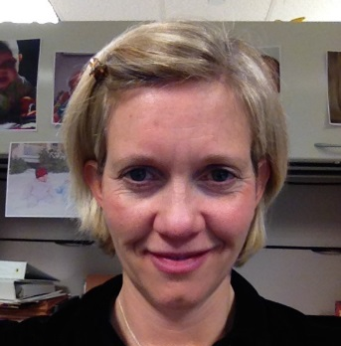
Introductions
Presenter: Sangeeta Parikshak
Office of Head Start
Presenter: Laura Duos
Office of Special Education Programs
Presenter: Christy Kavulic
Office of Special Education Programs
Presenter: Julia Martin Eile
Office of Special Education Programs
Moderator: Pam Winton
National Center on Early Childhood Development, Teaching & Learning &
FPG Child Development Institute
Notes:
We are pleased to be joined by Sangeeta Parikshak from the Department of Health and Human Services, Office of Head Start. We are also joined by Laura Duos, Christy Kavulic, and Julia Martin Eile from the Department of Education, Office of Special Education Programs. Pam Winton from the National Center on Early Childhood Development, Teaching and Learning and Frank Porter Graham Child Development Institute will serve as our moderator for today’s call. Pam, I’m going to turn it over to you now.

Slide 4
DEC/NAEYC Position Statement on Early Childhood Inclusion
Notes:
(Slide: DEC/NAEYC Position Statement screen shot) Thanks Megan. To start our conversation today, I’d like to provide some context: What do we mean by participation in the context of inclusion, and why is participation considered an essential feature of high quality inclusion? What you see on the screen is a 2009 Joint Position Statement on Inclusion from two professional organizations in our field (National Association for the Education of Young Children (AKA NAEYC) and Division for Early Childhood of the Council of Exceptional Children (AKA CEC). In this statement they identified participation as one three essential features of high quality inclusion. What this means is that simply providing access to inclusive programs is not enough. It is what happens in those inclusive programs that is critically important in promoting positive outcomes for young children with disabilities.

Slide 5
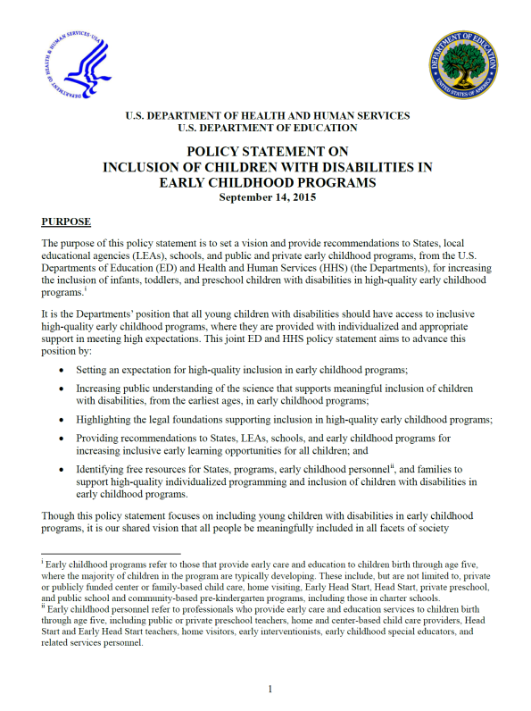
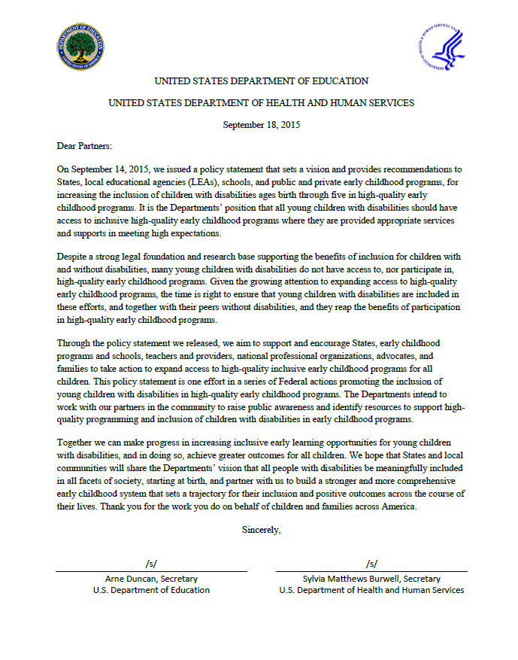
Federal Policy Statement
Inclusion of Children with Disabilities in Early Childhood Programs
www.ed.gov/early-learning
www.acf.hhs.gov/programs/ecd
Notes:
Now you see the joint federal policy statement on inclusion released by the US Departments of Education and Health & Human Services in 2015. This statement dug deeper in defining what is meant by participation.

Slide 6
Definition of Participation
“…holding high expectations and intentionally promoting participation in all learning and social activities by making individualized accommodations and using evidence-based services and supports to foster children’s development (cognitive, language, communication, physical, behavioral, and social-emotional), to foster friendships with peers, and to create a sense of belonging. This applies to all young children with disabilities, from those with the mildest disabilities, to those with the most significant disabilities.”
(Federal Policy Statement on Inclusion, 2015)
Notes:
To paraphrase from that statement it means “ holding high expectations and intentionally promoting participation in all learning and social activities by making individualized accommodations and using evidence-based services and supports to foster children’s development (cognitive, language, communication, physical, behavioral, and social-emotional) , to foster friendships with peers, and to create a sense of belonging. This applies to all young children with disabilities, from those with the mildest disabilities, to those with the most significant disabilities”.

Slide 7
Learning Outcomes
Understand the Head Start Performance Standards and other federal policies and laws related to providing services and supports for children with suspected or identified disabilities.
Know about evidence-based practices that promote active engagement, participation and sense of belonging in home, community and educational settings for children with suspected or identified disabilities.
Know about resources associated with policies and practices that support the engagement, participation and sense of belonging for children with suspected or identified disabilities.
Understand each sector’s basic role in ensuring that young children with diagnosed or suspected disabilities experience evidence-based practices, and appropriate services and supports they need to learn and develop to reach their maximum potential.
Notes:
Outcomes of the webinar;
Understand laws and policies on this topic
Know about evidence-based practices that promote active and meaningful participation in home, community and educational settings
Learn about resources that support implementation of those practices
Understand each sectors roles in ensuring that children with diagnosed or suspected disabilities receive the services and supports they need to learn and develop to reach their full potential

Slide 8
What does Inclusion Look like across the nation? what does it tell us about participation?
Notes:
To start us out, let’s take a look at what inclusion looks like across the nation and what these data can tell us about this essential feature of high quality inclusion: participation. Christy , will you share some of the state data that the Office of Special Education Programs at US Dept of ED collects annually that addresses
Early childhood educational environments data provides information on where young children with disabilities receive services. These data are related to access to inclusive settings and showcase whether children receive services within a regular early childhood program, including Head Start, Childcare, school programs, etc. (Maybe comment on national data and enormous variability across states)
WE NEED TO SPP/APR data once maps are revised.

Slide 9
What data does OSEP collect?
Indicator 6a-Percent of children who attend a regular early childhood program and receive the majority of special education and related services in the program
National data- 45%
Indicator 6b-Percent of children who attend a special education classroom, separate school or residential facility
National data- 25%
Notes:
Early childhood educational environments data provides information on where young children with disabilities receive services. These data are related to access to inclusive settings and showcase whether children receive services within a regular early childhood program, including Head Start, Childcare, school programs, etc. (Maybe comment on national data and enormous variability across states)
WE NEED TO SPP/APR data once maps are revised
From the published 2015-16 static tables (618 data)
6a 44.84 so 45
6b 25
Last year rounded up it was 44 and 26. Moving slowly!

Slide 10
Indicator 6a https://www2.ed.gov/fund/data/report/idea/partbspap/allyears.html
20-40%
41-60%
61-80%
81-100%
Notes:
SPP/APR Link to Reports - https://www2.ed.gov/fund/data/report/idea/partbspap/allyears.html
Share educational environments data across states
Christy
Early childhood educational environments data provides information on where young children with disabilities receive services. These data are related to access to inclusive settings and showcase whether children receive services within a regular early childhood program, including Head Start, Childcare, school programs, etc. (Maybe comment on national data and enormous variability across states)
This map shows how each State is reporting data on children in special classrooms, separate school or residential facility. As you can see the data varies across the country.
Its one thing to have services in the classroom to inform us about participation of children with disabilities, but the data we want to know more about is the evidence based practices that help support their participation in typical settings.

Slide 11
Indicator 6b https://www2.ed.gov/fund/data/report/idea/partbspap/allyears.html
0-20%
21-40%
40-60%
Notes:
SPP/APR for Part B for each state can be found at: https://www2.ed.gov/fund/data/report/idea/partbspap/allyears.html
This map shows how each State is reporting data on children in special classrooms, separate school or residential facility. As you can see the data varies across the country.
Its one thing to have services in the classroom to inform us about participation of children with disabilities, but the data we want to know more about is the evidence based practices that help support their participation in typical settings.
.

Slide 12
Dear Colleague Letter related to Preschool Least Restrictive Environment (LRE)
https://www2.ed.gov/policy/speced/guid/idea/memosdcltrs/preschool-lre-dcl-1-10-17.pdf
Notes:
The link is correct
Moderator Q: We have heard from some parents that even though their children are in inclusive settings and theoretically receive their services in those preschool settings, sometimes their children are pulled out into an isolated place like a small room to receive services , while the rest of the children are having group learning activities or even bused to another place to receive services. Laura, Is there a policy about this practice?
Christy: That is correct. While this is not best practice or the preference, we know this issue is quite complex. It’s really important that early childhood programs work together to ensure preschool children with disabilities receive services in their least restrictive environment and are fully engaged and participating. We know this can be a challenge and we often hear about children being bused between programs to receive services for a variety of reasons.
The joint policy statement discusses the need to consider children who are dually placed in more than one program and eliminate policies that require unnecessary transitions between service providers that can burden families, disrupt service delivery, and interrupt child progress.
In addition, to the joint policy statement, OSEP re-issued the Dear Colleague letter on Least Restrictive Environments on Jan 9, 2017. Laura can you say a little bit more about the letter?

Slide 13
Least Restrictive Environment (LRE) Dear Colleague Letter (DCL)
OSEP Issued the DCL on January 9, 2017 to reaffirm the position of the Department that all young children with disabilities should have access to inclusive high-quality early childhood programs where they are provided with individualized and appropriate supports to enable them to meet high expectations.
The LRE requirements have existed since passage of the Education for all Handicapped Children Act (EHA) in 1975 and are a fundamental element of our nation’s policy for educating students with disabilities (the EHA was renamed the Individuals with Disabilities Education Act (IDEA) in 1990). These requirements reflect the IDEA’s strong preference for educating students with disabilities in regular classes with appropriate aids and supports.
Notes:
Laura Duos
On January 9th we revised and reissued a 2012 DCL addressing the implementation of LRE provisions in preschools. Since the 2012 letter was issued, there has been additional guidance on early learning inclusion and an expansion of early learning opportunities but we continue to receive questions about how the IDEA LRE provisions apply to preschools so we decided to update the letter.
Overall, the letter reaffirm the position of the Department that all young children with disabilities should have access to inclusive high-quality early childhood programs where they are provided with individualized and appropriate supports to enable them to meet high expectations
The Letter reaffirms the position of the Dept of ED that all young children with disabilities should have access to inclusive high-quality early childhood programs. It walks you through the LRE provisions which have existed since the since passage of the Education for all Handicapped Children Act (EHA) in 1975. These requirements reflect the IDEA’s strong preference for educating students with disabilities in regular classes with appropriate aids and supports.
Specifically, it states to the maximum extent appropriate, children with disabilities, including children in public or private institutions or other care facilities, must be educated with children who are not disabled. Further, special classes, separate schooling, or other removal of children with disabilities from the regular educational environment occurs only when the nature or severity of the disability of a child is such that education in regular classes with the use of supplementary aids and services cannot be achieved satisfactorily. Throughout the letter we emphasize that all of these provisions apply to preschool children with disabilities.
The letter also goes through the IDEA Placement provisions – overriding rule is that the it is individually determined based on child’s abilities and needs as described in the child’s IEP. Before placement outside the regular setting it is required that group making the decision consider supplementary aids and services that could be provided to would enable the education of child in regular ed setting.
We also make clear that when determining placement options for a child with a disability who already participates in a regular public preschool program, including a community-based regular public preschool program operated by a public agency other than the LEA, unless the child’s IEP requires some other arrangement, the child is educated in the school that he or she would attend if nondisabled.
We also added a data section which clarifies the definition regular early childhood program and a funding section which walks through how Part B funds cab be used to p[ay for preshcool placement, both public and private.

Slide 14
Least Restrictive Environment (LRE) Dear Colleague Letter (DCL)
Placement decisions regarding a preschool child with a disability who is served under Part B of IDEA must be individually determined based on child’s abilities and needs as described in the child’s individualized education program (IEP).
Before a child is placed outside the regular education environment, the group of persons making the placement decision must consider whether supplementary aids and services could be provided that would enable the education of the child, including a preschool child with a disability, in the regular educational setting to be achieved satisfactorily.
Notes:
Laura Duos
On January 9th we revised and reissued a 2012 DCL addressing the implementation of LRE provisions in preschools. Since the 2012 letter was issued, there has been additional guidance on early learning inclusion and an expansion of early learning opportunities but we continue to receive questions about how the IDEA LRE provisions apply to preschools so we decided to update the letter.
Overall, the letter reaffirm the position of the Department that all young children with disabilities should have access to inclusive high-quality early childhood programs where they are provided with individualized and appropriate supports to enable them to meet high expectations
The Letter reaffirms the position of the Dept of ED that all young children with disabilities should have access to inclusive high-quality early childhood programs. It walks you through the LRE provisions which have existed since the since passage of the Education for all Handicapped Children Act (EHA) in 1975. These requirements reflect the IDEA’s strong preference for educating students with disabilities in regular classes with appropriate aids and supports.
Specifically, it states to the maximum extent appropriate, children with disabilities, including children in public or private institutions or other care facilities, must be educated with children who are not disabled. Further, special classes, separate schooling, or other removal of children with disabilities from the regular educational environment occurs only when the nature or severity of the disability of a child is such that education in regular classes with the use of supplementary aids and services cannot be achieved satisfactorily. Throughout the letter we emphasize that all of these provisions apply to preschool children with disabilities.
The letter also goes through the IDEA Placement provisions – overriding rule is that the it is individually determined based on child’s abilities and needs as described in the child’s IEP. Before placement outside the regular setting it is required that group making the decision consider supplementary aids and services that could be provided to would enable the education of child in regular ed setting.
We also make clear that when determining placement options for a child with a disability who already participates in a regular public preschool program, including a community-based regular public preschool program operated by a public agency other than the LEA, unless the child’s IEP requires some other arrangement, the child is educated in the school that he or she would attend if nondisabled.
We also added a data section which clarifies the definition regular early childhood program and a funding section which walks through how Part B funds cab be used to p[ay for preshcool placement, both public and private.

Slide 15
Head Start and Early Head Start Data on Children with Disabilities
HS Program Information Report (PIR) 2015-2016 program year
12.4% of children enrolled in HS and migrant programs have an IEP
11.99% of children enrolled in EHS and migrant programs have an IFSP
Notes:
Moderator: Thank you Laura and Christy for sharing the latest info and policies from OSEP on what inclusion looks like across the nation and policies that support inclusion.
Sangeeta, thank you for going next and sharing some of the latest Head Start data and policies related to inclusion and especially about the quality of children’s inclusive experiences.
The annual Head Start Program Information Report (PIR) must be completed by all programs funded by the federal government to operate Head Start and Early Head Start programs.
As mentioned in the previous webinar: A minimum of 10% enrollment of children with disabilities is required program-wide since 1972.
In 2015, cumulative enrollment was 1,099,078 and 12.3% of enrollees were children with disabilities (133,136).
12.4% of children enrolled in HS and migrant programs have an IEP
56.68% of these children entered the program already determined eligible to receive these services
43.31% were determined eligible to receive special education and related services during this enrollment year
Of these, the number who have not received services are 1.10%
11.99% of children enrolled in EHS and migrant programs have an IFSP
64.15% of these children entered the program already determined eligible to receive these services
35.86% were determined eligible to receive services during this enrollment year
Of these, the number who have not received early intervention services under IDEA is 0.99%
Primary delay or disability – top three
Speech or language impairments (6.84%)
Non-categorical/developmental delay (3.91%)
Autism (0.39%)
Other diagnoses from PIR data: health impairment, emotional disturbance, intellectual disabilities, hearing impairment, orthopedic impairment, visual impairment, specific learning disability, traumatic brain injury; Multiple disabilities (excluding deaf-blind) (0.13%)

Slide 16
Head Start and Early Head Start Data on Children with Disabilities
Collaboration agreements and community engagement
Notes:
LEAs
Number of LEAs in service area: 19,573
Number of formal agreements the program has with LEAs to coordinate services for children with disabilities: 14,607
Public school Pre-K programs
Program has Formal collaboration and resource sharing agreements: 2,171
Part C agencies
Number of Part C agencies in the program’s service area: 8,109
Number of formal agreements the program has with Part C agencies to coordinate services for children with disabilities: 6,235
The Office of Head Start requires that at least 10% of children enrolled in a Head Start program have an identified disability (unless they have a waiver); and we collect annual data to document that program’s are meeting that expectation. However, I think it would be fair to say that these data do not provide information on the extent to which programs are ensuring that children are fully engaged and participating in those settings. And the same is true of these collaborative relationships…we don’t know how many are being actively implemented or the quality of those agreements. This makes it hard for us to really address some important questions about quality and participation. And Christy, would you say that is true of the OSEP state data? It doesn’t address the issues of quality and the extent to which children are actively participating in ways that promote their learning and development?
Christy- Yes, I agree Sangeeta. Both of these data sources focus on access to inclusive settings. We need to support states and programs to dig deeper by identifying ways to understand the quality of inclusive programs and how programs provide appropriate supports, such as embedded, routines-based teaching, explicit interventions, scaffold learning, and tiered models, to ensure full participation and engagement that lead to the positive outcomes for children that we feel are important.

Slide 17
Head Start Early Learning Outcomes Framework: Ages Birth to Five
The Head Start Early Learning Outcomes Framework: Ages Birth to Five describes the skills, behaviors, and knowledge programs must foster in all children.
The Framework guides programs in decision-making related to curriculum, assessment, quality improvement, and implementing evidence-based teaching practices that promote strong positive child outcomes.
Programs use the Framework to plan instruction
and design opportunities for children to learn, play,
explore, discover, and form relationships in a positive
and stimulating environment.
Notes:
Moderator: So let’s talk a bit about digging deeper and looking at those desired outcomes for children and families and the practices that support reaching those outcomes. Both HHS and ED have invested quite a bit of time and energy in identifying outcome frameworks and practice guidelines that in my view provide important guidance to the field in terms of doing what you both are talking about – that is, focusing on ensuring that young children with disabilities are meaningfully participating in inclusive environments.
Shall we start with the Outcomes? Sangeeta, can you tell us a bit about the new Early Learning Outcomes Framework (ELOF) released by the Office of Head Start in 2016.

Slide 18
Head Start Early Learning Outcomes Framework: Ages Birth to Five
Guiding principles:
Each child is unique and can succeed.
Learning occurs within the context of relationships.
Families are children’s first and most important caregivers, teachers and advocates.
Children learn best when they are emotionally and physically safe and secure.
Areas of development are integrated, and children learn many concepts and skills at the same time.
Teaching must be intentional and focused on how children learn and grow.
Every child has diverse strengths rooted in their family’s culture, background, language, and beliefs.
Notes:
Moderator: So let’s talk a bit about those desired outcomes and the practices that support reaching those outcomes. Both HHS and ED have invested quite a bit of time and energy in identifying outcome frameworks and practice guidelines that in my view provide important guidance to the field in terms of doing what you both are talking about – that is, focusing on ensuring that young children with disabilities are meaningfully participating in inclusive environments.
Shall we start with the Outcomes? Sangeeta, can you tell us a bit about the new Early Learning Outcomes Framework (ELOF) released by the Office of Head Start in 2016.

Slide 19
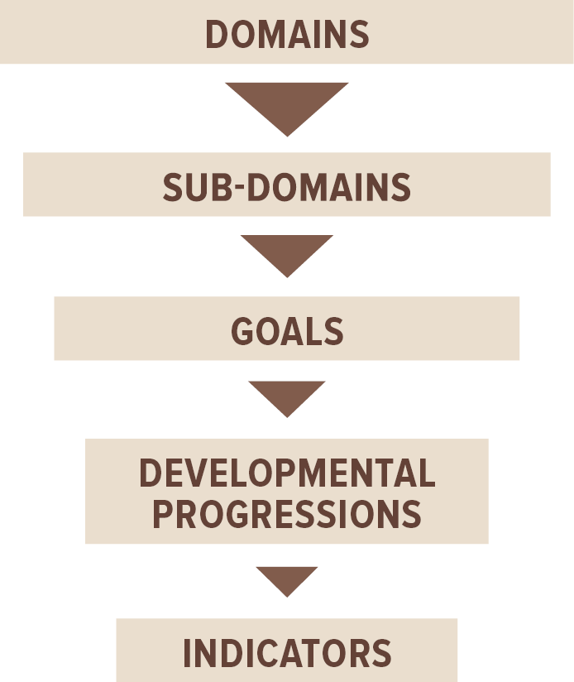
Head Start Early Learning Outcomes Framework: Ages Birth to Five
Notes:
The structure of the framework includes:
The Domains are broad areas of early learning and development from birth to 5 years that are essential for school and long-term success.
The Sub-Domains are categories or components of development within a domain.
The Goals are broad statements of expectations for children’s learning and development.
The Developmental Progressions describe the skills, behaviors and concepts that children will demonstrate as they progress towards a given goal within an age period.
The Indicators describe specific observable skills, behaviors, and concepts that children should know and be able to do at the end of Early Head Start (by 36 months) or at the end of Head Start (by 60 months).

Slide 20
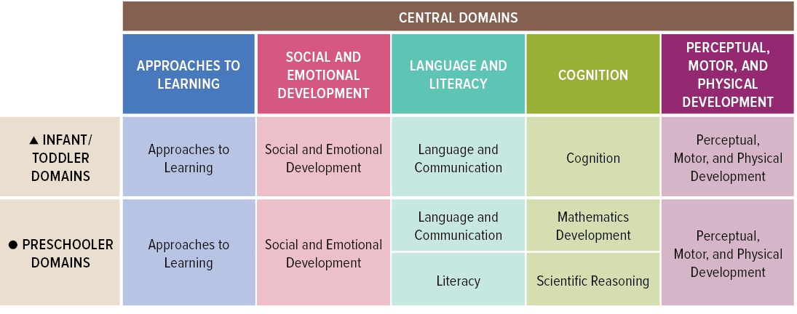
Head Start Early Learning Outcomes Framework: Ages Birth to Five

Slide 21
Head Start Early Learning Outcomes Framework: Ages Birth to Five
Children with Disabilities
Individualized instruction in order to develop and learn the skills described in the Framework may be needed.
Use the Framework in collaboration with specialists identified on the child’s IFSP, IEP, or 504 plan.
Identify children’s strengths and abilities to ensure that learning opportunities are maximized and that children are fully included in all educational experiences and activities.
Notes:
The Framework can be used for:
Infants and toddlers, preschoolers, dual language learners, and children with disabilities.

Slide 22
OSEP Early Childhood Outcomes
In 2005, the Office of Special Education Programs (OSEP) began requiring State Early Intervention and Preschool Special Education programs to report on child outcomes and the family indicator.
For child outcomes, States are required to report on the percent of infants and toddlers with Individualized Family Service Plans (IFSPs) or preschool children with Individualized Education Programs (IEPs) who demonstrate improved:
Positive social-emotional skills (including social relationships);
Acquisition and use of knowledge and skills (including early language/communication [and early literacy]); and
Use of appropriate behaviors to meet their needs.
Notes:
Moderator: Julia, OSEP also has an outcomes framework that is part of the state monitoring process. Could you tell us about that?
OSEP has moved from a compliance driven accountability system in which we measured timeliness of services, to a results driven accountability system where we focus on outcomes and program improvement. Similar to Head Start’s Early Learning Outcomes Framework, OSEP has also looked closely at early childhood outcomes for infants, toddlers and preschool children with disabilities.
In 2005 (for 12 years), the Office of Special Education Programs (OSEP) began requiring State Early Intervention and Preschool Special Education programs to report on child outcomes
The Child Outcomes
The Three outcomes are considered critical to children becoming active and successful participants across a variety of settings. All states are required to report data to OSEP on these outcomes:
Positive social-emotional skills (including social relationships);
Acquisition and use of knowledge and skills (including early language/communication [and early literacy]); and
Use of appropriate behaviors to meet their needs.

Slide 23
Early Childhood Outcome | What does it mean?
Positive social emotional skills (including social relationships). | Making new friends and learning to get along with others is an important accomplishment of the early childhood years. Children develop a sense of who they are by having rich and rewarding experiences interacting with adults and peers.
Acquisition and use of knowledge and skills (including early language/ communication [and early literacy*]). | Over the early childhood period, children display tremendous changes in what they know and can do. The knowledge and skills acquired in the early childhood years, such as those related to communication, pre- literacy and pre-numeracy, provide the foundation for success in kindergarten and the early school years.
Use of appropriate behaviors to meet their needs. | As children develop, they become increasingly more capable of acting on their world. With the help of supportive adults, young children learn to address their needs in more sophisticated ways and with increasing independence. They integrate their developing skills, such as fine motor skills and increasingly complex communication skills, to achieve goals that are of value to them.
Notes:
OSEP feels these 3 outcomes are important for the infant, toddler and preschool children with a disability to achieve. This data is collected at entry and exit of the child’s experience in early intervention and preschool. The data is collected and reported to OSEP through an Annual Performance Report.
Postivie Social Emotional –
In addition……They also learn that different rules and norms apply to different everyday settings and that they need to adjust their behavior accordingly. This outcome involves relating to adults, relating to other children, and for older children, following rules related to groups or interacting with others. The outcome includes concepts and behaviors such as attachment/separation/autonomy, expressing emotions and feelings, learning rules and expectations in social situations, and social interactions and social play.
Aqusition and use of knowledge and skills
This outcome involves activities such as thinking, reasoning, remembering, problem solving, number concepts, counting, and understanding the physical and social worlds. It also includes a variety of skills related to language and literacy including vocabulary, phonemic awareness, and letter recognition.
* for children 3 through 5
Use of Appropriate Behaviors to meet needs = Self Help - This outcome involves behaviors like taking care of basic needs, getting from place to place, using tools (such as forks, toothbrushes, and crayons), and, in older children, contributing to their own health, safety, and well-being. It also includes integrating motor skills to complete tasks; taking care of one’s self in areas like
dressing, feeding, grooming, and toileting; and acting on the world in socially appropriate ways to get what one wants.
This data along with the settings data gives us a better idea of the experiences a child is having and the success the child is having in the program, however, the evidence based practices are also very important.
Positive social emotional skills (including social relationships). Making new friends and learning to get along with others is an important accomplishment of the early childhood years. Children develop a sense of who they are by having rich and rewarding experiences interacting with adults and peers.
Acquisition and use of knowledge and skills (including early language/ communication [and early literacy*]). Over the early childhood period, children display tremendous changes in what they know and can do. The knowledge and skills acquired in the early childhood years, such as those related to communication, pre- literacy and pre-numeracy, provide the foundation for success in kindergarten and the early school years.
Use of appropriate behaviors to meet their needs. As children develop, they become increasingly more capable of acting on their world. With the help of supportive adults, young children learn to address their needs in more sophisticated ways and with increasing independence. They integrate their developing skills, such as fine motor skills and increasingly complex communication skills, to achieve goals that are of value to them.

Slide 24
Outcomes Data
In 2014-2015, for Part C (birth through age 2),
♦ The percentage of children who showed greater than expected growth was between 67% and 75% across the three outcomes. These children were acquiring skills at a faster rate when they left the program than when they began it.
♦ The percentage of children who exited the program functioning within age expectations ranged from 50% for knowledge and skills to 59% for social relationships.
In 2014-15, for Part B Preschool (ages 3 through 5)
♦ The percentage of children who showed greater than expected growth was between 77% and 79% across the three outcomes.
Notes:
Here is the Early Childhood Outcomes Data for 2015-2015. This analysis is completed by ECTA every year and as you can see for Part C children we see a greater than expected growth based on participation in the program. The growth across the three outcomes is between 67 and 75%.
Similar in Part B – OSEP is seeing greater than expected growth based on participation in the program. As we mentioned before this is great data for OSEP, however it does not measure the the quality of the program the children attend and the evidence based practices.

Slide 25
2014 DEC Recommended Practices
http://www.dec-sped.org/recommendedpractices
Notes:
Julia to Christy: So Christy, can you tell us what are the practices that have the strongest evidence for supporting these early childhood outcomes?
Christy: DEC Recommended Practices: (Christy)
“The DEC Recommended Practices were developed to provide guidance to practitioners and families about the most effective ways to improve the learning outcomes and promote the development of young children, birth through five years of age, who have or are at-risk for developmental delays or disabilities.”
“The DEC Recommended Practices support children's access and participation in inclusive settings and natural environments and address cultural, linguistic, and ability diversity. They also identify key leadership responsibilities associated with the implementation of these practices.”

Slide 26
Goal of the DEC Recommended Practices
The goal of the Recommended Practices is to inform and improve the quality of services provided to young children with or at risk of disabilities or delays and their families.
The Recommended Practices bridge the gap between research and practice by highlighting those practices that have been shown to result in better outcomes for young children with disabilities, their families, and the personnel who serve them.
Notes:
Christy - A very systematic two year process was used to update and streamline the practices in order to improve the quality of services provided to young children with or at risk of disabilities or delays and their families.

Slide 27
Process for Identifying DEC Recommended Practices
Research-Based Practices
Experience & Professional Wisdom
Field Validation
26
Notes:
This process involved and ongoing and systematic review of the research literature, and a field validation that involved major stakeholders. There is a plan in place to update the practices over time as new research emerges.

Slide 28
2014 DEC Recommended Practices
8 Topic Areas:
Environment
Instruction
Interaction
Assessment
Teaming
Family
Leadership
Transition
27
Notes:
The practices are organized into 8 topic areas. Note that these are not just child-focused practices but include families, teaming, leadership, and transition

Slide 29
DEC Recommended Practice Parameters
Supported by research, values and experience
Represent breadth of topic
Observable
Not disability specific
Delivered in all settings (natural/inclusive environments)
Build on and are not duplicative of other standards (such as NAEYC DAP)
28
Notes:
Describe parameters by talking more in detail about the bullets
Practices focus on practitioners and leaders working with 0-5 children, who have or are at risk for developmental delays and disabilities; not limited to those eligible for IDEA services
Recommended Practices are supported by research, values, and experience.
Recommended Practices represent the breadth of the topic area.
Recommended Practices are observable.
Recommended Practices are not disability-specific.
Recommended Practices can be delivered in all settings including natural/inclusive environments.
Recommended Practices should build on, but not duplicate, standards for typical early childhood settings such as the NAEYC Developmentally Appropriate Practices.

Slide 30
Response to Intervention (RTI)
Framework that helps practitioners link assessment to instruction
Assessment Component (Formative) where information is gathered to inform the instruction
Instructional Component that includes the core curriculum and layered on top is the tiered interventions to help support the student
Data is used for data based decision making
Family engagement – ways for teachers and parents to work together – setting benchmarks and goals
Notes:
Moderator Q: Christy, it has occurred to me and to many others that these DEC RP are really applicable to each and every children – the concept of individualizing is one that resonates across all ec practitioners, although we know for sure that some children need more intensive supports than others. Can you speak about how practitioners can make decisions about what levels of support a specific child might need?
Christy- Yes, we feel strongly that the DEC Recommended Practices are applicable to all children in all settings. We also know that these practices work well with more intensive supports for children who may need them and so they can participate fully in a high quality inclusive setting.
RTI is a comprehensive continuum of practices designed to provide a quick response to a child’s needs. It is based on teachers being able to continuously observe and recognize when a child is struggling to develop and learn and then using that data to make decisions about how to modify and adapt the curriculum and respond to the children's needs. This ensures that interventions needed for each individual child are provided in a timely and intentional fashion. It also allows for families to be involved in working together and setting goals for the child.

Slide 31
Head Start Program Performance Standards
Strong, Targeted Services for Children with Disabilities
Ensure that programs include all children including those with an IEP and IFSP.
Providing supports for children with significant delays who are not eligible for IDEA
Transition services to support children with disabilities moving to Kindergarten
Coordinated approach to serving children with disabilities and their families
Notes:
Moderator: Sangeeta, how do the new HSPPS’s support implementation of the practices we just learned about?
In general, the new Standards implement changes from 2007 HS Act which replaced reliance on Head Start programs to evaluate some children and provide IEPs to make it clear such services are entitlements under IDEA. Programs have followed the statute since it was enacted, but the regulations now accurately reflect the Act.
1302 Subpart C, Education and Child Development Services, ensuring that programs include all children including those with an IEP and IFSP. Subpart C recognizes that some children with delays may not be eligible for IDEA but benefit from additional supports and services. For example, the standards state that if a child has a significant delay, the program must partner with parents to help the family access services and supports to help address the child’s identified need and that it may be appropriate for the program to provide these services and supports under Section 504 of the Rehabilitation Act.
There are different definitions/criteria for identifying a child with a disability by state. Therefore, a child who may qualify for services under IDEA in one state may not in another state. Furthemore, there are some diagnoses such as ADHD for which a child would definitely benefit from supports and this is where Section 504 comes into play.
Subpart G, transition services, stating that programs must provide transition services to support children with disabilities and their families as they prepare to leave the program. The standards state that the transition services take into account the child’s disability status, the Individual Family Service Plan (IFSP) for children in EHS and the Individualized Education Program (IEP) for children in HS.
Furthermore, 1302 Subpart J, Program Management, states that programs must implement a coordinated approach to serving children with disabilities and their families. This means that the standards maintain requirements for programs to coordinate and collaborate with local agencies responsible for implementing IDEA, Part B (preschool) and Part C (infant and toddler) services to ensure appropriate referral, evaluation, service delivery and transition.
The standards maintain requirements for programs to coordinate and collaborate with local agencies responsible for implementing IDEA, Part B (preschool) and Part C (infant and toddler) services to ensure appropriate referral, evaluation, service delivery and transition.

Slide 32
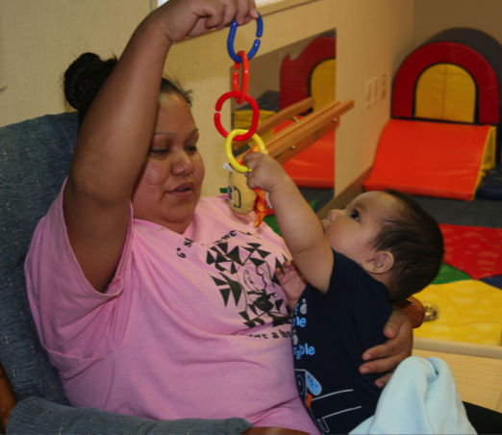
Head Start Program Performance Standards
Additional Services for Children with Disabilities
Provide individual services and supports to the maximum extent possible to children awaiting determination of IDEA eligibility
Parent engagement
Notes:
1302.61 in Subpart F includes a new requirement for programs to provide individual services and supports to the maximum extent possible to children awaiting determination of IDEA eligibility
The HSPPS really do weave in parent engagement throughout the standards. An example of how it is discussed regarding children with disabilities is that the standards recognize parents’ role in the IEP and IFSP process and prepare parents to advocate for their children.
Moderator: So between HHS and ED there are some solid policies in place to guarantee that if children are suspected of having special needs, they can get referred for an evaluation to determine exactly what kinds of service and supports will meet their needs. In addition, Head Start/EHS is a welcoming inclusive setting with arms wide open to children with disabilities. Please type in questions for Sangeeta.
Mention the last webinar is available and URL is avialble in last slide

Slide 33
Individualized Education Program (IEP)
Assessment of child needs
Child centered goals
Services and strategies for meeting goals
Settings for which the services are provided in the least restrictive environment for Part B preschool (Head Start, public preschool)
Notes:
Moderator: Another question from our audience: - How do you know if a child’s IEP goals are being addressed in a Head Start or child care program?
Julia: The IEP is a tool that can be used to document individualized outcomes and use of evidence-based practices. Practitioners and specialists working in partnership with families are key ingredients to ensuring active, engaged participation. IIEPs should include location of services and goals for the child.
A strong IEP team will include all of the individuals who come into contact with the child such as therapists, but also teachers, head start teachers, disability coordinators, etc. It is important that the team determine the best setting for the child with supports and services to allow him or her to learn in the natural environment or LRE.

Slide 34
To post your ongoing questions: Online Disabilities/Inclusion Network
https://mypeers.mangoapps.com/mlink/post/NzA0NDE

Slide 35
Upcoming Events
The National Early Childhood Inclusion Institute – May 9-11, 2017 in Chapel Hill, NC. Information & registration at http://inclusioninstitute.fpg.unc.edu
The Head Start Disabilities Coordinator Institute – April 5, 2017 in Chicago, IL (Registration will open soon)

Slide 36
Webinar Link
The link the the last webinar in the series, Partnerships for Inclusion: Ensuring Access to High Quality Evaluations and Services can be found at:
https://eclkc.ohs.acf.hhs.gov/hslc/tta-system/teaching/Disabilities/quality-inclusion.html

Slide 37
Resources
Resources to help with the implementation of the DEC Recommended Practices:
DEC Recommended Practices: http://www.dec-sped.org/dec-recommended-practices
ECTA Performance Checklists and Practice Guides: http://ectacenter.org/decrp/
CONNECT Modules: http://community.fpg.unc.edu/connect-modules/
Resources on the Early Childhood Outcomes:
http://ectacenter.org/eco/index.asp
General resources on inclusion:
http://ectacenter.org/topics/inclusion/default.asp
Notes:
Moderator to panel: Are there some resources you can point us to that address these evidence based practices that support Individualization? Resources
Share ECTA resources that support implementation of the DEC Recommended Practices (Megan or Julia)
Share Resources that Support Practices for Individualization COMING SOON (Sangeeta)

Slide 38
Resources
OSEP Dear Colleague Letter (DCL) related to Preschool Least Restrictive Environment (LRE): https://www2.ed.gov/policy/speced/guid/idea/memosdcltrs/preschool-lre-dcl-1-10-17.pdf
Head Start Early Learning Framework: https://eclkc.ohs.acf.hhs.gov/hslc/hs/sr/approach/elof
Head Start Program Performance Standards: http://eclkc.ohs.acf.hhs.gov/hslc/hs/docs/hspss-final.pdf

Slide 39
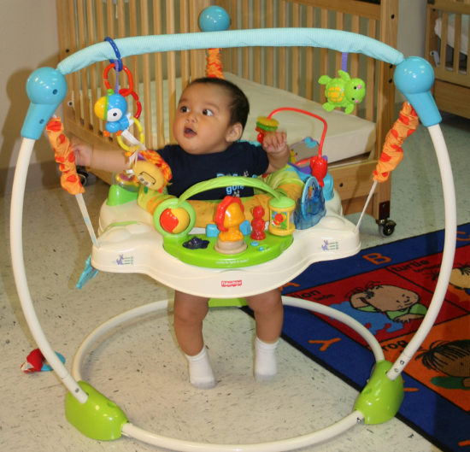
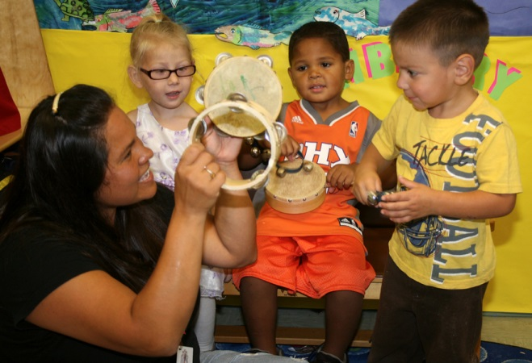
Thank You!
Please stay tuned for the following webinars in this series on High Quality Inclusion:
Support – April 2017
Notes:
Keep tuned for the upcoming webinars
Look for evaluation via email
We will notify you when the webinar ppts are available.

Slide 40
We want to partner to build a culture of inclusion!
Laura.Duos@ed.gov
Christy.Kavulic@ed.gov
Julia.Martin.Eile@ed.gov
Sangeeta.Parikshak@acf.hhs.gov
Pam_Winton@unc.edu
Megan.Vinh@unc.edu
https://eclkc.ohs.acf.hhs.gov/hslc/tta-system/teaching
www.ectacenter.org
Notes:
And thank you to our panelists who exemplify the word partnership.

